Slide 1

DEPARTMENT OF COMPUTER SCIENCE AND ENGINEERING
CSC1365 BIG DATA ANALYTICS (PRBL)
PROJECT REVIEW
PRESENTED BY SUPERVISOR
K. KRISHKANTH Mrs. R. INDRA DEVI, M.E.,
CSA2351 ASSISTANT PROFESSOR
8115U23CS051 CSE
DATE:
18/09/2025

Slide 2
Twitter sentiment analysis using Apache Hadoop and Spark

Slide 3
Introduction
Twitter provides a vast source of real-time public opinions and trends.
Manual analysis of this massive and fast data is impractical.
The project automates tweet collection and performs sentiment analysis using Hadoop and Spark.
It helps understand public sentiment and emerging topics efficiently.

Slide 4
Objective
Collect and store live and historical Twitter data in Hadoop HDFS.
Process and clean data using Apache Spark for scalable analysis.
Perform sentiment classification on tweets (positive, negative, neutral).
Visualize sentiment trends and provide actionable insights through dashboards.

Slide 5
Problem Identification
Massive volume and velocity of tweets make manual analysis impossible.
Extracting meaningful sentiment insights requires scalable tools.
Tweets are often informal with slang and emojis, complicating analysis.
Need for an automated, big data solution to process and analyze Twitter streams.

Slide 6
Problem Analysis
Twitter API provides access, but large-scale ingestion needs robust storage (HDFS).
Tweets require cleaning and structuring before sentiment evaluation.
Distributed processing (using Spark) is essential for handling big data.
Sentiment analysis tools must handle informal text specific to social media.

Slide 7
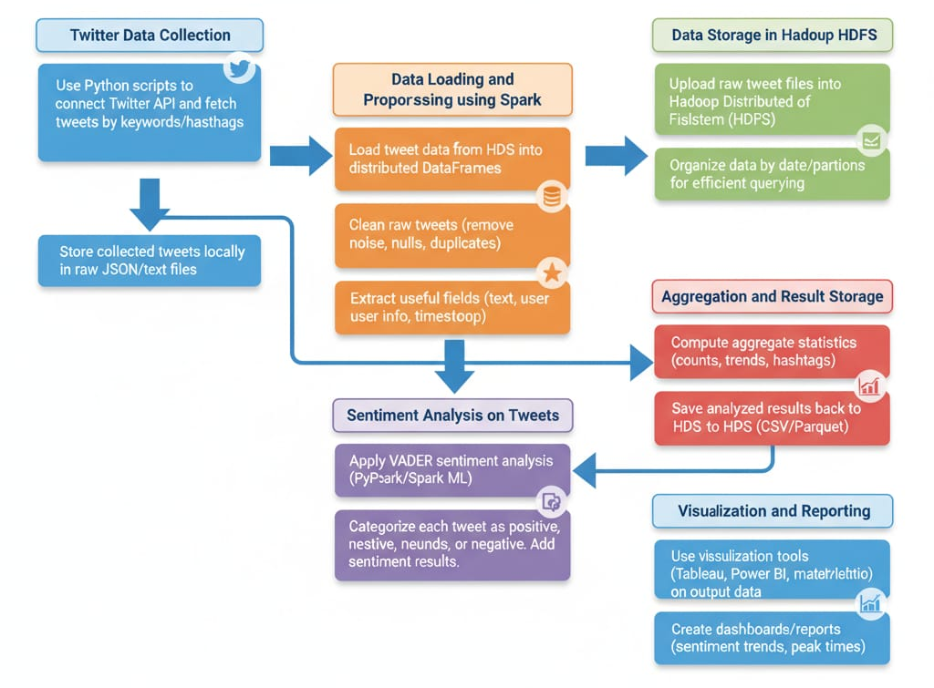
Project Flow Diagram (Design)

Slide 8
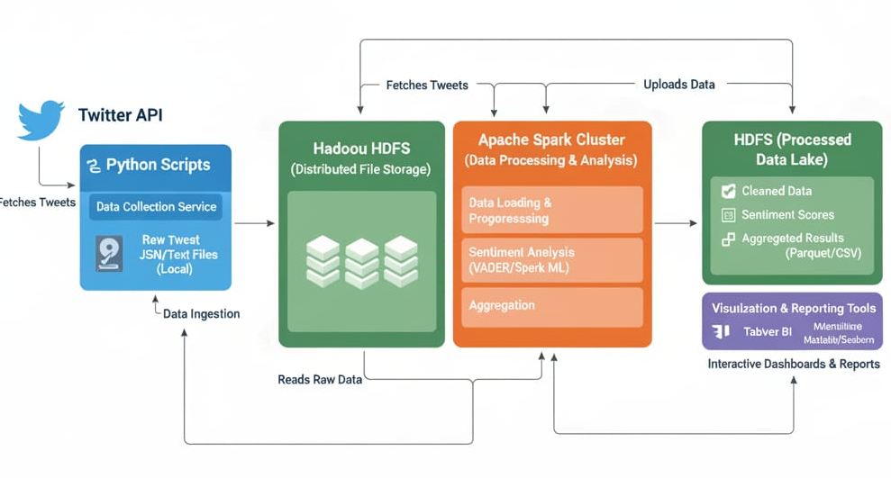
Architecture Diagram (Design)

Slide 9
Module Design
Twitter Data Ingestion (Python + API)
Data Storage (HDFS)
Data Analysis with Spark & Python
Sentiment Analysis ( Spark with VADER)
Results Visualization/Reporting

Slide 10
Twitter Data Ingestion (Python + API)
Uses Python scripts with Twitter’s official API to collect tweets.
Authenticates with user API keys and searches by keywords/hashtags.
Fetches tweets at set intervals or via streaming endpoints, storing results locally.
Can batch or schedule collection scripts, providing control over data acquisition.

Slide 11
Data Storage (HDFS)
Raw tweet JSON/text files are uploaded directly to Hadoop HDFS.
Stores data in organized, date-based folders for easy management and querying.
HDFS offers distributed, reliable storage for high tweet volumes.
Prepares tweet data for fast, parallel processing in Spark.

Slide 12
Data Analysis (Spark + Python)
Spark loads tweet files from HDFS into distributed DataFrames.
Processes and cleans tweet text, removing noise and extracting key fields.
Uses PySpark to enable cluster-based, scalable data transformations.
Prepares and structures tweets for downstream sentiment analysis.

Slide 13
Sentiment Analysis ( Spark with VADER)
Integrates VADER sentiment analysis in PySpark for large batches.
Assigns sentiment labels (positive/negative/neutral) to each tweet.
Handles emojis, slang, and informal language common in tweets.
Stores sentiment output alongside original tweet text for reporting.

Slide 14
Results Visualization/Reporting
Presents sentiment-labeled results for monitoring or exploration.
Saves processed results back into HDFS or as CSV/Parquet files.
Creates summary statistics (e.g., sentiment counts/trends) with Spark SQL or Pandas.
Supports further visualization or dashboards in BI tools or Python libraries.

Slide 15


